Slide 1
Towards Integrating Archaeological Resources and Data in Landscape Planning & Design
Nathan R. Lawres, Ph.D.
Antonio Waring, Jr. Archaeological Laboratory
Department of Anthropology
University of West Georgia
Carrollton, GA
nlawres@westga.edu

Slide 2
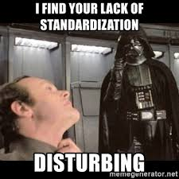
Archaeological data = important resource
If at front end of planning
Spatial data is key
Statewide databases & differences
Variability in data quality, durability, & efficacy of use
We need standardization!!

Slide 3
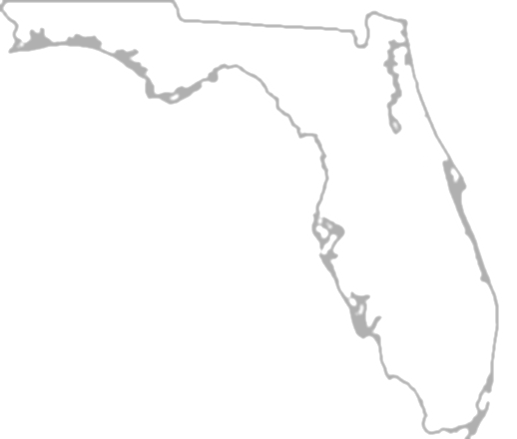
Evaluating Statewide GIS databases
Starting point: Pennsylvania & Florida
2 primary reasons:
1 – Pennsylvania Cultural Resource GIS already being used
2 – Florida = highly distinct context for comparison

Slide 4
Key Differences
Our evaluation highlights 3 primary differences
1 – Database Structure
2 – National Register of Historic Places Determinations
3 – Chronological & Cultural Affiliations

Slide 5
Pennsylvania Cultural Resources GIS (PACRGIS)
Relational database structure
42 linked tables plus shapefiles
139,539 features
116,275 historic, 23,164 archaeological

Slide 6
Pennsylvania Cultural Resources GIS (PACRGIS)

Slide 7
Pennsylvania Cultural Resources GIS (PACRGIS)

Slide 8
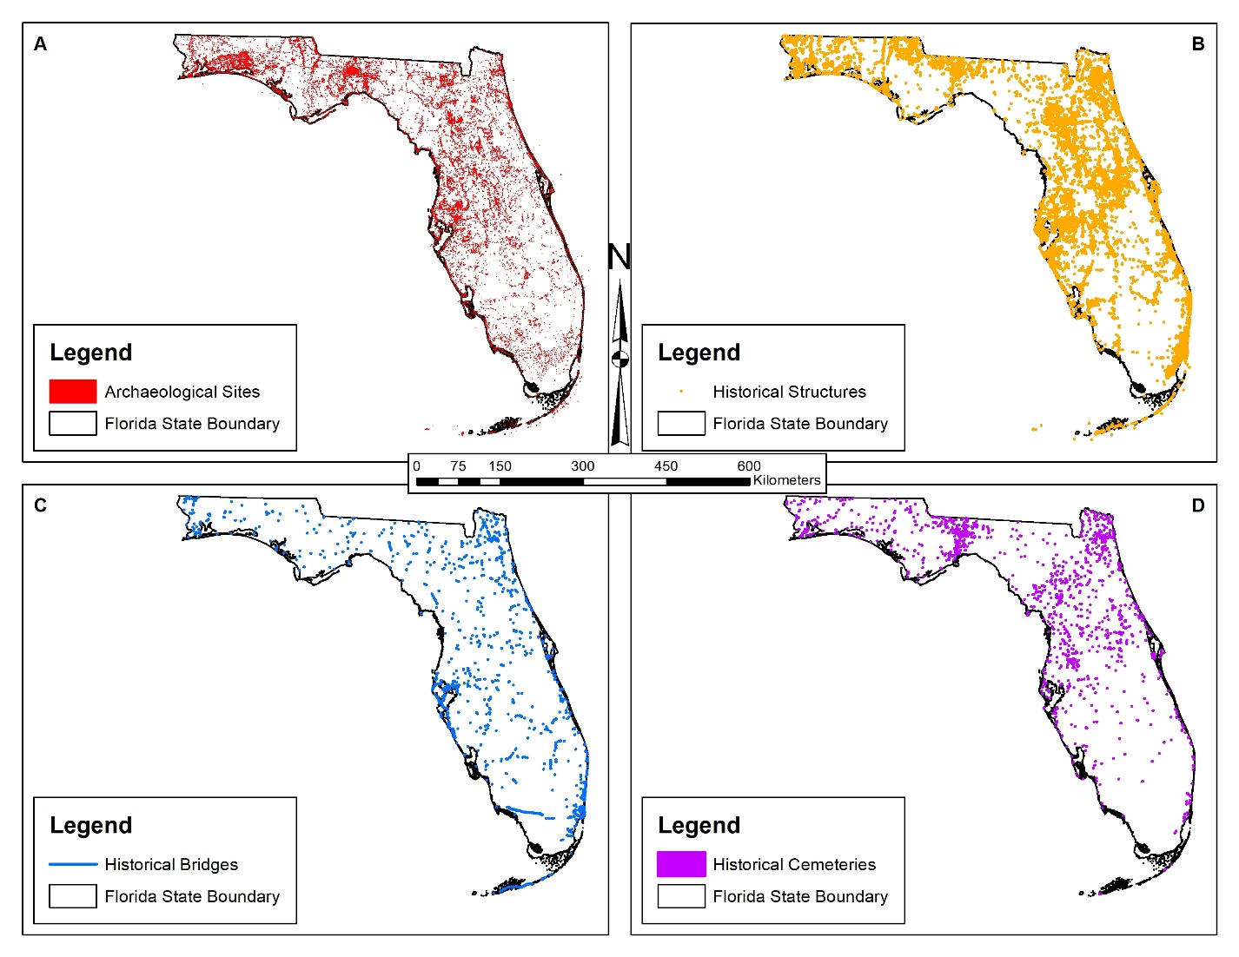
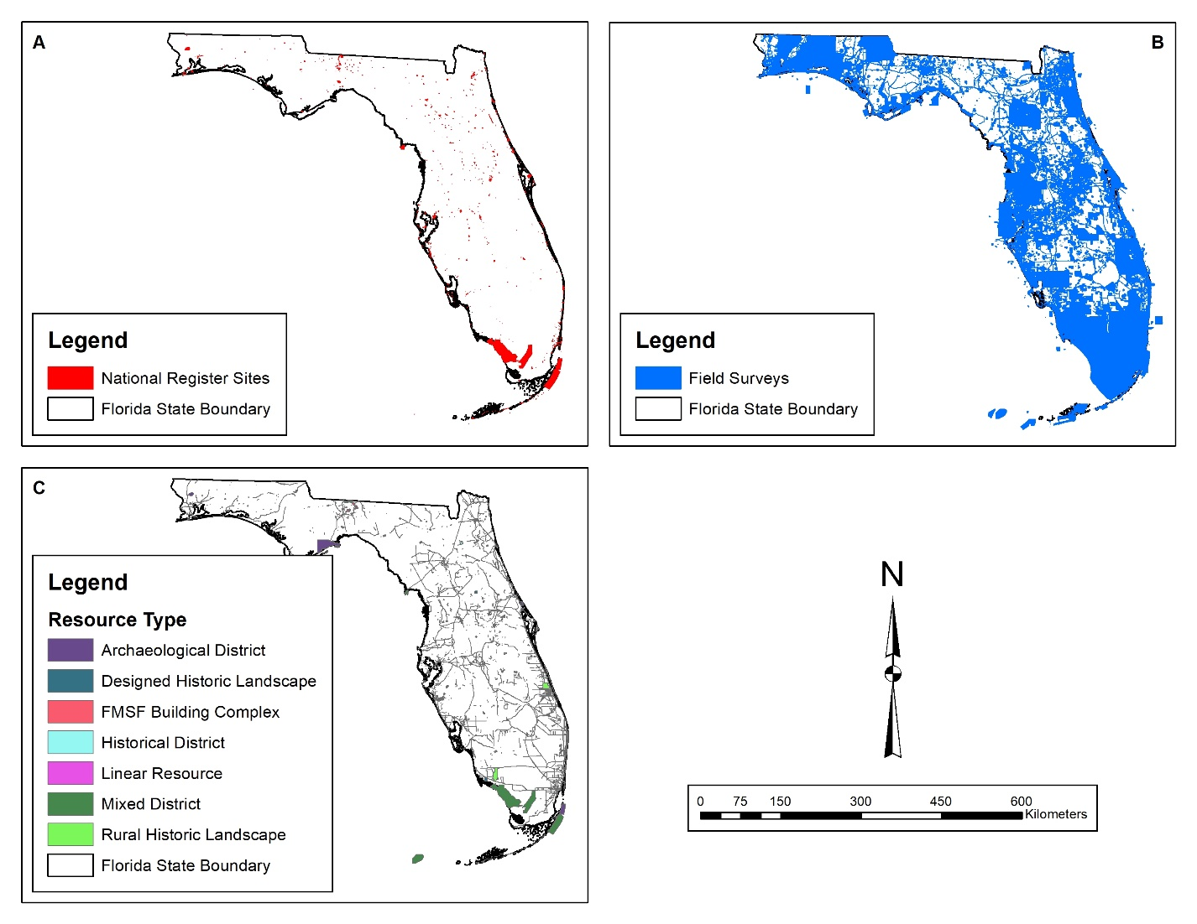
Florida Master Site File (FMSF)
Individual shapefile structure
No overarching database
Archaeological sites shapefile
35,257 features

Slide 9
Florida Master Site File (FMSF)

Slide 10
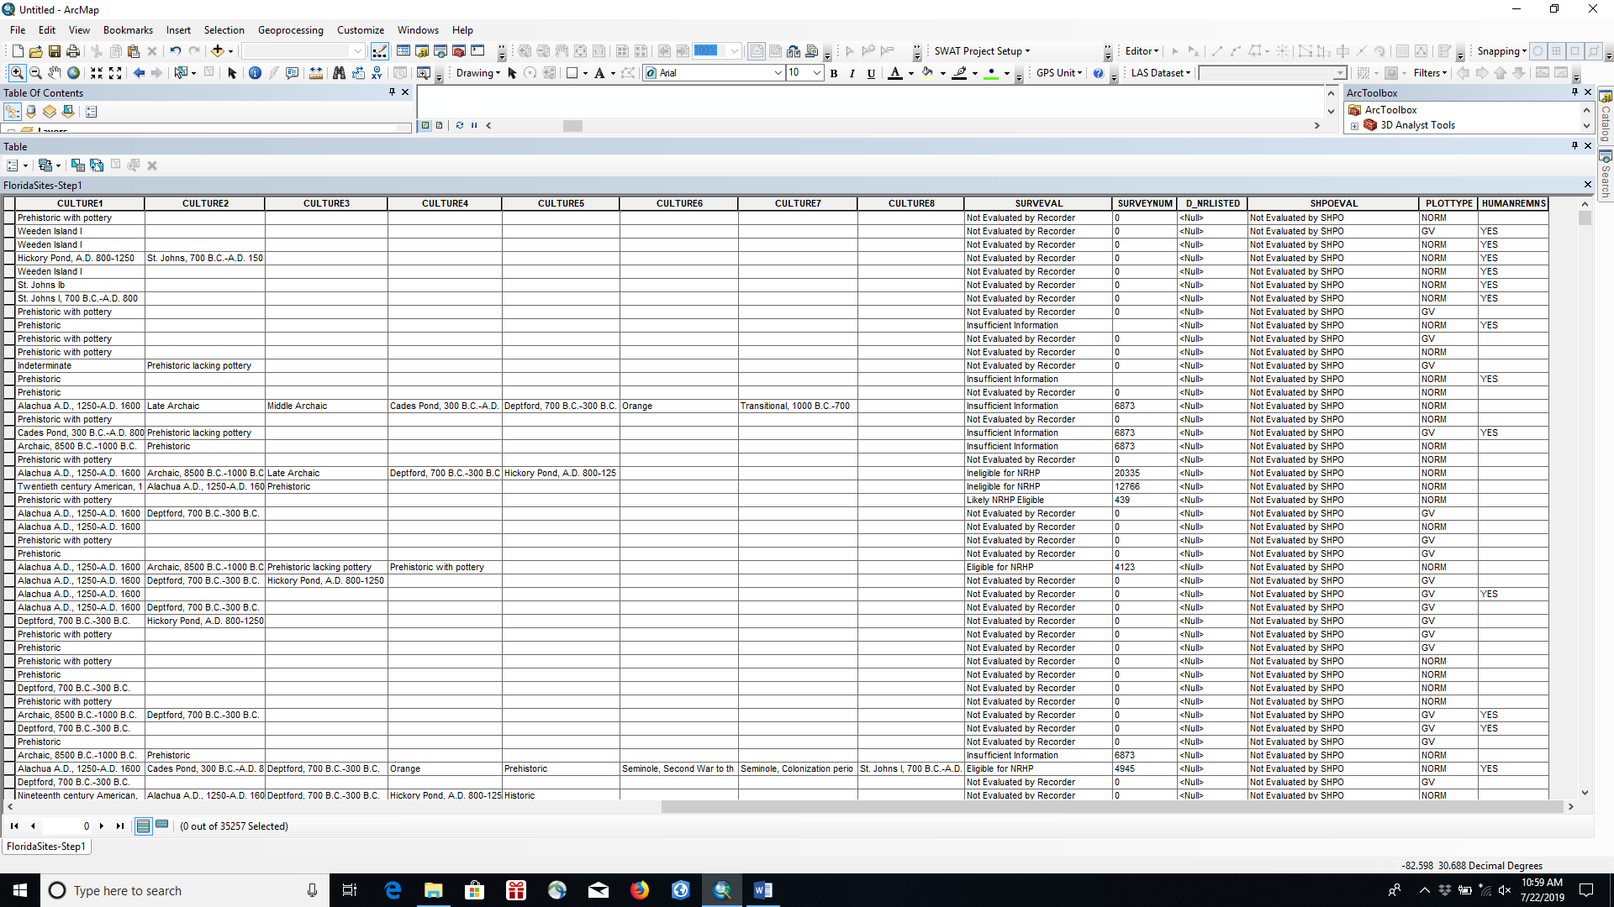
Florida Master Site File (FMSF)

Slide 11
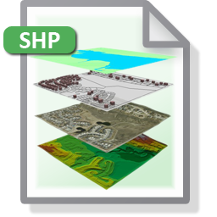
Key Issues
Standardization in structure needed
Relational database:
Complex, cumbersome, GIS experience necessary
PACRGIS offers online simplified portal
Individual shapefiles:
Easily manipulated, transferable
Requires software on user device ($$$)

Slide 12
Key Issues
Relational database structure recommended
Contain more data & more types of data
Increases data durability
Easily linked to other statewide datasets

Slide 13
Key Issues
Need Standardization in National Register Eligibility Determinations
FMSF uses additional categories
Potentially Eligible & Not Evaluated by SHPO
Differential conceptualizations of eligibility determinations
Need to comply with 36 CFR 60
FMSF |  |  | PHMC
Category | # of Sites | % of Total | Category | # of Sites | % of Total
Destroyed | unknown | unknown | Destroyed | 594 | 2.56%
Eligible | 1156 | 3.27% | Eligible | 518 | 2.24%
Potentially Eligible | 571 | 1.62% | Ineligible | 1255 | 5.42%
Ineligible | 10790 | 30.56% | Insufficient Information | 16985 | 73.32%
Insufficient Information | 2894 | 8.20% | Listed | 154 | 0.66%
Not Evaluated by SHPO | 19891 | 56.35% | Nat. Historic Landmark | 14 | 0.06%
NRHP Listed* | 162* | 0.458%* | … | … | …
Total | 35302 | 100.00% | Total | 23164 | 100.00%

Slide 14
Key Issues
Need Standardization in Documenting Preservation State
PACRGIS: % intact
FMSF: NONE!!!!
Necessary data for planning

Slide 15
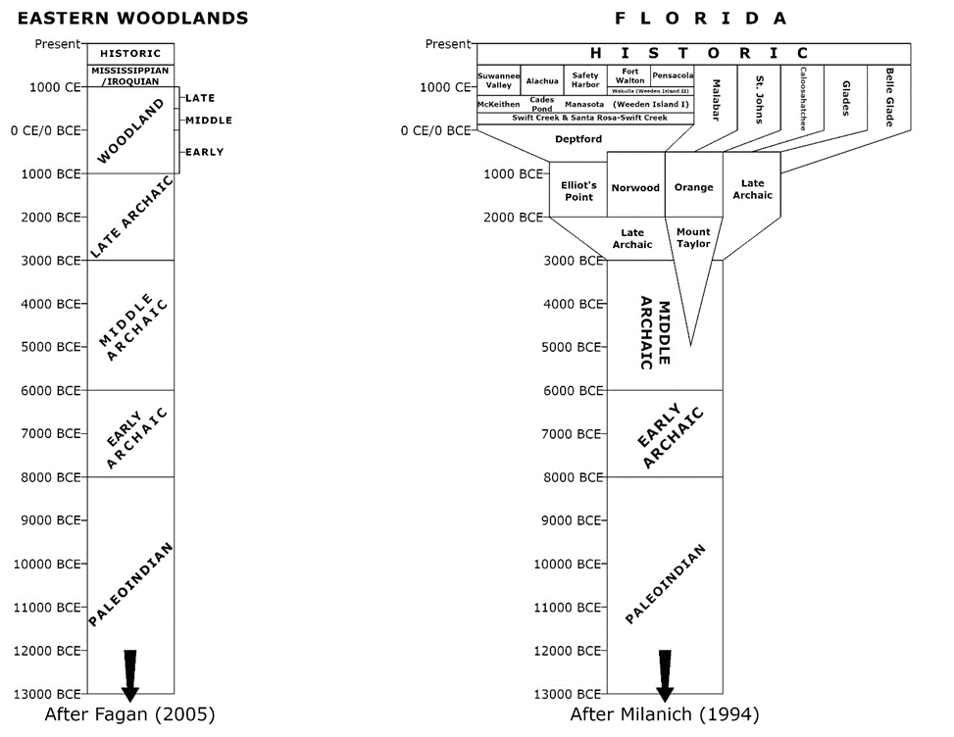
Key Issues
Need Standardization in Chronological & Cultural Affiliations
PACRGIS: broad, regional chronology, no culture
FMSF: parochial system based on state culture regions
Recommend having both types present
Allows for work at multiple scales, increases data sharing opportunities

Slide 16
Concluding Remarks
Standardization is beneficial for archaeologists and collaborators
3 primary areas for standardization:
1 – database structure
2 – NRHP eligibility determinations
3 – cultural & chronological affiliations

